Slide 1
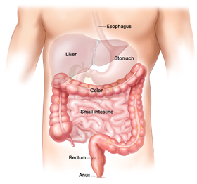
INTESTINAL BIOME RESTORATION SUPPLEMENTS

Slide 2
DISORDERS OF THE GUT BIOME / BACTERIA
Gut Bacteria, the Biome is thought to play a role in various diseases, It’s the collection of microorganisms that live in our digestive tract.
Inflammatory bowel disease
Ulcerative Colitis
Irritable bowel disease
Type 2 diabetes
Hypertension
Colorectal cancer
Atopic Eczema
Allergic diseases
Auto Immune Disease
Anxiety and Depression
Neurological conditions, schizophrenia and dementia
Obesity
Leaky Gut

Slide 3
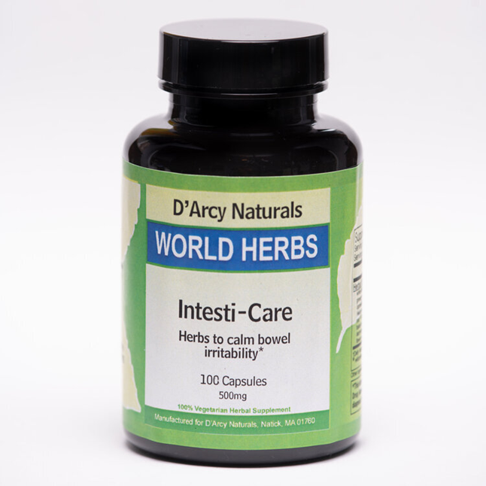
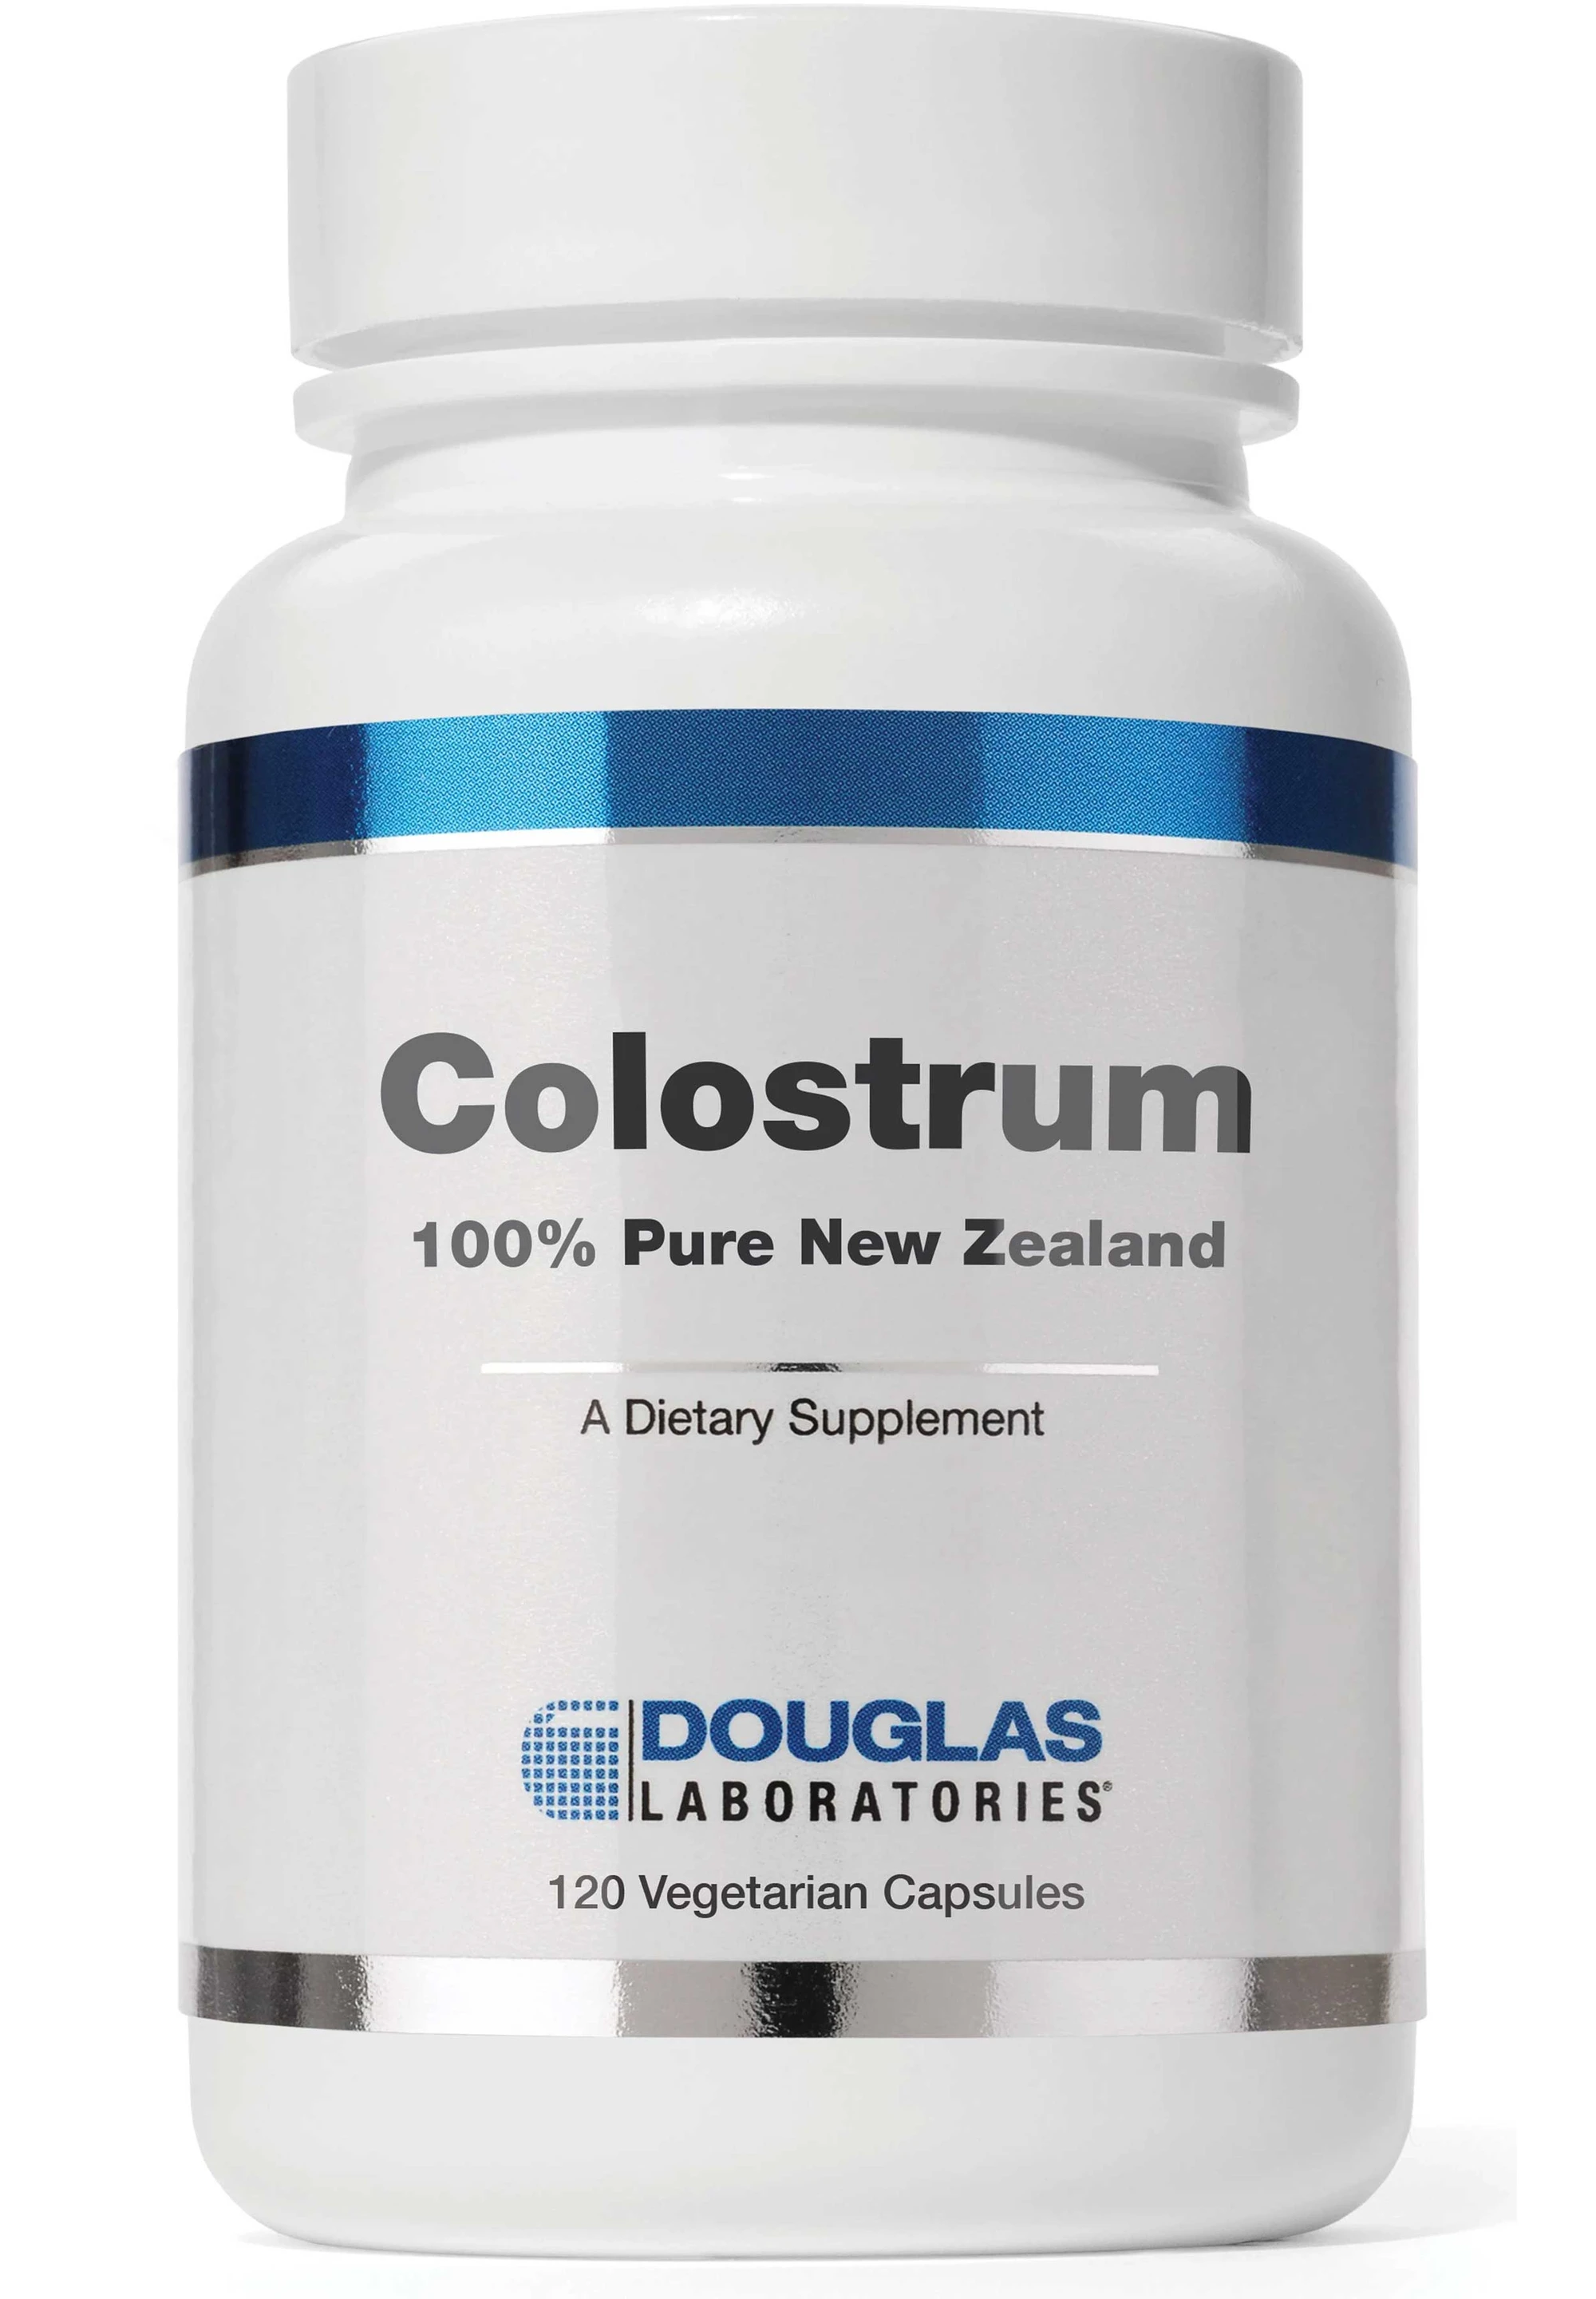
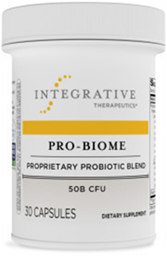
BIOME RESORATION SUPPLEMENT PROGRAM
1. Intesti-Care Herbal Formula
2. Colostrum
3. Probiotics
ORDER CALL 508-650-1921

Slide 4
INTESTI-CARE FORMULA Intesti-Care Formula is one of the most common formulations of traditional Chinese medicine (TCM) for the treatment of Ulcerative Colitis
Microbiome analysis revealed that this formula improved the abundance of intestinal microbiota (ecological communities of microorganisms" multicellular organisms studied to date from plants to animals. Microbiota include bacteria, archaea, protists, fungi and viruses. )
This formula is for intestinal health, irritable bowel syndrome, also known as nervous indigestion, mucous colitis, damage to mucosa or spastic colitis. This helps support the biome and mucosa recovery. IBS is a common disorder of the large intestine or bowel from which some 15% of the U.S. suffer.
The formula is based on the Chinese classic, with lotus seed to stop diarrhea, and dioscorea yam, which is easily digested to strengthen digestion and energy. Cardamon rids the body of dampness, allowing the other herbs to tonify without stagnation.

Slide 5
INTESTI-CARE FORMULA Shen-Ling-Bai-Zhu-San (SLBZS) Clears Inflammation and Improves the Biome
Microbiome analysis revealed that Shen-Ling-Bai-Zhu-San (SLBZS) improved the abundance of intestinal microbiota
https://www.sciencedirect.com/science/article/abs/pii/S0753332218306176
Intesti-Care Formula is one of the most common formulations of traditional Chinese medicine (TCM) for the treatment of Ulcerative Colitis. Researchers have found that dioscorea, or wild yam, has significant antioxidant activity, and is very useful to reduce or eliminate spasming in the intestines.

Slide 6
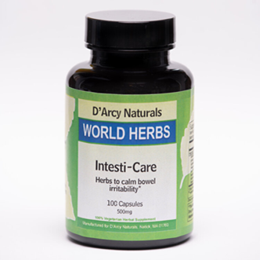
OVER 140 ARTICLES AND STUDIES ON THE
INTESTI-CARE FORMULA CHINESE FORMULA
Shen-Ling-Bai-Zhu-San alleviates functional dyspepsia in rats and modulates the composition of the gut microbiota.
Zhang S, Lin L, Liu W, Zou B, Cai Y, Liu D, Xiao D, Chen J, Li P, Zhong Y, Liao Q, Xie Z.Nutr Res. 2019 Nov;71:89-99. doi: 10.1016/j.nutres.2019.10.001. Epub 2019 Oct 29.PMID: 31757632
Shen-ling-bai-zhu-san, a spleen-tonifying Chinese herbal formula, alleviates lactose-induced chronic diarrhea in rats.Ji HJ, Kang N, Chen T, Lv L, Ma XX, Wang FY, Tang XD.J Ethnopharmacol. 2019 Mar 1;231:355-362. doi: 10.1016/j.jep.2018.07.031. Epub 2018 Jul 31.PMID: 30071269
Shen-ling-bai-zhu-san ameliorates inflammation and lung injury by increasing the gut microbiota in the murine model of Streptococcus pneumonia-induced pneumonia.
Feng J, Dai W, Zhang C, Chen H, Chen Z, Chen Y, Pan Q, Zhou Y.BMC Complement Med Ther. 2020 May 27;20(1):159. doi: 10.1186/s12906-020-02958-9.PMID: 32460745 Free PMC article.
Impact of Antibiotics on Necrotizing Enterocolitis and Antibiotic-Associated Diarrhea.
Silverman MA, Konnikova L, Gerber JS.Gastroenterol Clin North Am. 2017 Mar;46(1):61-76. doi: 10.1016/j.gtc.2016.09.010.PMID: 28164853 Free PMC article. Review.
A review of pharmacological and clinical studies on the application of Shenling Baizhu San in treatment of Ulcerative colitis.
Ma Q, Ouyang Y, Meng F, Noolvi MN, Avvaru SP, More UA, Aminabhavi TM, Du M, Liu H, Zhuang Y, Pang M, Cai T, Cai Y.J Ethnopharmacol. 2019 Nov 15;244:112105. doi: 10.1016/j.jep.2019.112105. Epub 2019 Jul 22.PMID: 31344480 Review.
SEE ALL…. https://pubmed.ncbi.nlm.nih.gov/?linkname=pubmed_pubmed&from_uid=28219687

Slide 7
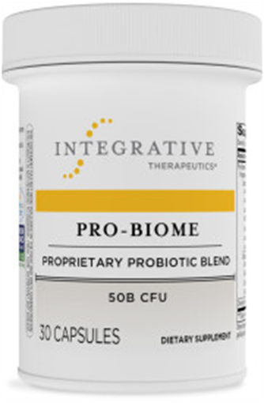
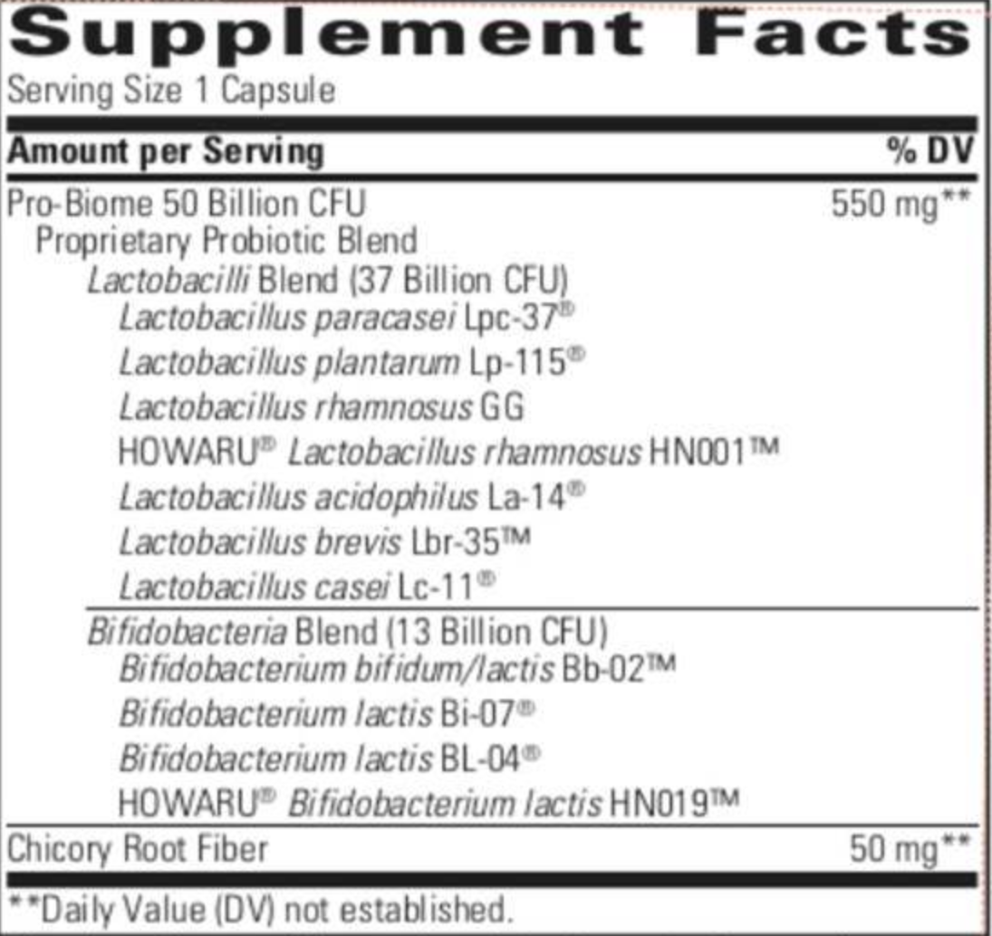
PRO-BIOTICS Pro-Biome 50 Billion
11 strains, 50 billion CFU per capsule
Dairy Free, Gluten Free, and DNA Authenticated.
Guaranteed to label claim at expiration
Guaranteed potency without refrigeration
Non-GMO Project Verified
SKU: 13770
Notes:
Is the bottle design a selling point?
Blend Breakdown at expiration:
LPC-37: 16.5B
Lp-115: 8.5B
GG: 5.3B
Bb-02: 3.3B
La-14: 3.3B
BL-04: 3.3B
HN001: 3.3B
Bi-07: 3.3
HN019: 3B
Lbr-35: .13B
Lc-11: .09B

Slide 8
Pro-Biotics for Gastrintestinal Problems
Pro-biotics Meaning "for life," probiotics are live microbial supplements given by mouth in a variety of ways to improve the balance of micro-organisms in the intestinal tract.
Its about balance between good and bad bacteria. Importantly, they are entirely natural substances. All animals, including man, have a large and complex population of bacteria and other micro-organisms in the intestine which are essential for the healthy functioning of the gut

Slide 10
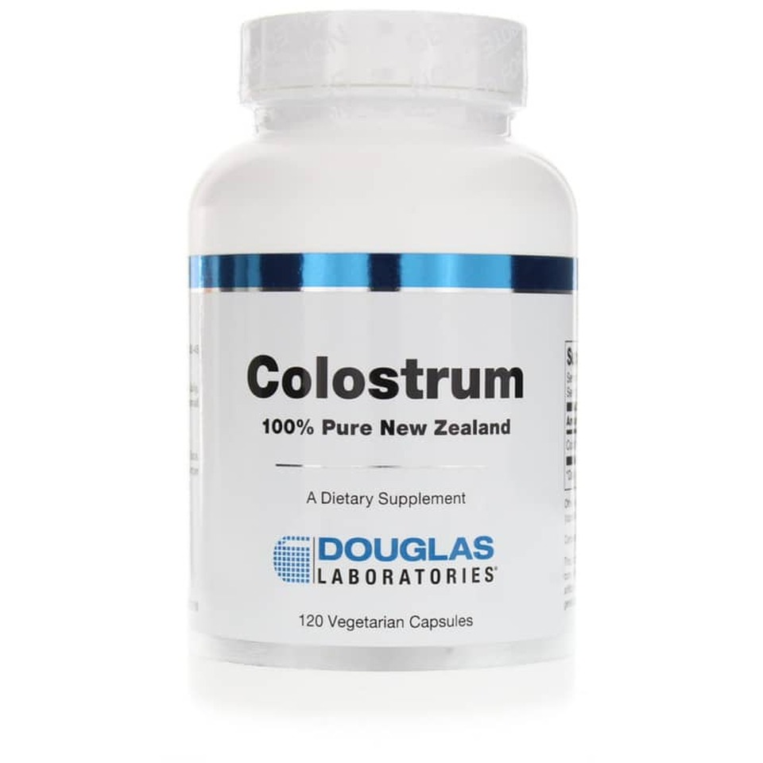
COLOSTRUM
Colostrum is Mother Nature’s first food for the developing microbiome in all mammals, our earliest and most potent influence on gut health and bacterial composition.
Colostrum provides a cornucopia of nutrients, immunoglobulins, passive antibodies, and signaling peptides that Mother Nature has perfectly honed to protect the newborn infant from infection, and to help train and shape the emerging immune system so it can handle its environment.
https://www.clinicaleducation.org/resources/reviews/colostrum-meets-the-microbiome-a-tried-and-true-remedy-for-gut-health-takes-center-stage/

Slide 11
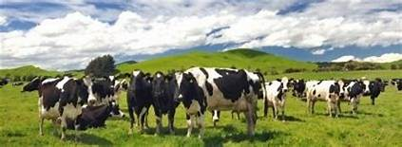
COLOSTRUM
Human Colostrum is the earliest breastmilk produced, beginning in mid-pregnancy (12-18 weeks) and is continually produced for the first few days after baby’s birth.
Encapsulated supplements have the best source of Colostrum from the early milk (first 2 milkings) of pasture fed, non-hyper-immunized, healthy New Zealand cows.
Year round grass fed New Zealand dairy herds develop stronger immunity to a wider range of pathogens than those which are fed processed feed, receive artificial hormone supplements or are kept indoors. This is because pasture raised cows are more exposed to the elements.
Free of GMO, Pesticides and Antibiotics
https://www.clinicaleducation.org/resources/reviews/colostrum-meets-the-microbiome-a-tried-and-true-remedy-for-gut-health-takes-center-stage/

Slide 12
Modern Life Depletes the Gut Biome?
Overuse of antibiotics, steroids, NSAIDS (aspirin, ibuprofen, etc)
Poor diet - high in refined foods and sugars and nutritional deficiencies
Heightened exposure to environmental toxins.
Stress
Contaminated Foods and Drinks by parasites like giardia lamblia, cryptosporidium, blastocystis hominis and other food and drinks contaminated by bacteria like helicobacter pylori, klebsiella, citrobacter, pseadomoas and other chemicals in fermented and processed food (dyes, preservatives, peroxidized fats);
Prescription corticosteroids (e.g. prednisone);
Prescription hormones like birth control pills; Homones in the food supply, meats.Hormone replacement therapy for Menopausal women

Slide 13
THE GUT BIOME

Slide 14
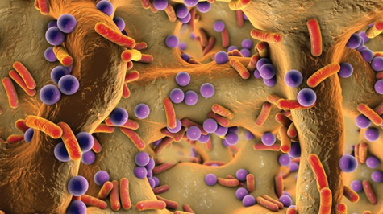
Approximately 80 percent of all pathogens enter the body through or attached to mucosal surfaces; and the largest of the mucosal surface is the gastrointestinal (GI) tract. The GI tract is also where most infectious organisms enter the body and where the antibodies and many different beneficial bacteria are produced and work to disarm invading pathogens and stop diseases before they take hold.
The GI tract is the foundation of the body’s good health. It has a HUGE surface area - The intestinal tract, while only 20 feet long, has a folding, undulating wall that maximizes surface area. A surface area of over 100 square yards is generated by this design allowing tremendous mechanical, chemical and absorptive efficiency.
The best-known illustration of the microbiome's importance is the use of "fecal transplants" to cure a life-threatening intestinal infection C. difficile.

Slide 15
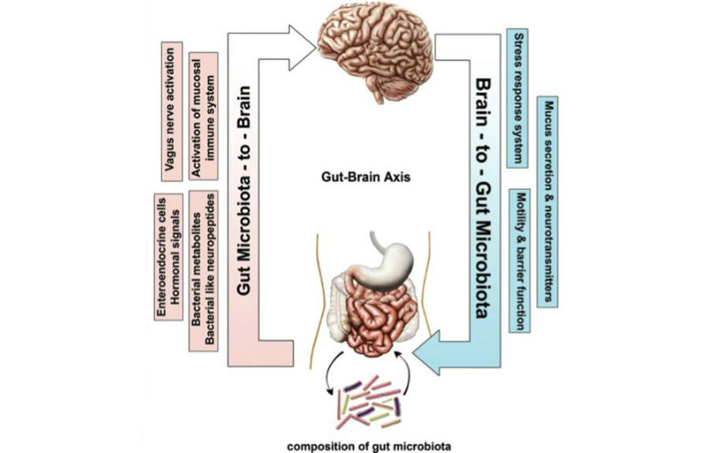
2 WAY STREET OF GUT-BRAIN HEALTH

Slide 16
The most diverse collection of bacteria ever found in humans,
The Yanomami indigenous people, who live in the Amazonian jungle in Venezuela, have the most diverse collection of bacteria ever found in humans, some of which had never been previously identified, says a study published in Science Advances.
Fibrous roots in the diet may allow a perfect environment for gut biome to flourish.
Without any contact of pharmaceuticals antibiotics, Western diet, modern stresses.

Slide 17
Papua New Guineans harbor biome communities with greater bacterial diversity, lower inter-individual variation, vastly different abundance profiles, and bacterial lineages undetectable in US.
https://www.sciencedirect.com/science/article/pii/S221112471500340X

Slide 18
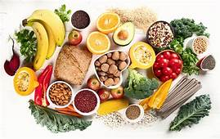
High-fiber diet can significantly alter the gut microbiome and nutrient intake
A short-term intervention in daily fiber consumption can significantly alter the gut microbiome and nutrient intake, according to a study led by University of California, Irvine researchers..
Dietary fiber consists of resistant carbohydrates found in fruits, vegetables and whole grains. Fiber persists in our digestion system, and while not digestible by humans, our gut bacteria can metabolize fiber into short-chain fatty acids and other byproducts critical to human health.
Currently, the average person in North America consumes less than 50 percent of the recommended dietary fiber levels due to decreased consumption of plant-based foods, as processed foods have become widespread.
https://www.news-medical.net/news/20210326/High-fiber-diet-can-significantly-alter-the-gut-microbiome-and-nutrient-intake.aspx

Slide 19
Leaky Gut
With leaky gut, the barrier is dysfunctional, blocking nutrients at the damaged villi while permitting toxins to enter the blood stream
Healthy mucosa allows nutrients to pass the barrier while blocking toxins

Slide 20
DEPLETED GUT LEAKY GUT Altered Intestinal Permeability
Allergies
Sluggish
Liver
Immune
Deficient
Candida
Autoimmune
Diseases
Food
Airborne
Chemical
Environmental
PMS, hormonal imbalance, depression, migraines, IBS confusion,, greater risks of cancer.
Less resistant to viruses,bacteria, parasites and candida
Diarrhea.
constipation,
bloating,
gas,
rectal itching,
vaginal
infections,
kidney, bladder
infections,
cystitis,sinusitis
Rheumatoid Arthritis
Lupus
polymyalgia rheumatica,
Multiple sclerosis,
Fibromyalgia,
C.F.S.,
Thyroditis,
Crohn's disease,
Ulcerative colitis,

Slide 21
Acupuncture for G.I Problems and I.B.S.
According to a randomized, controlled study in 2000, acupuncture is an effective form of treatment for IBS, particularly the pain and stress symptoms, and that its benefits exceed those of standard relaxation treatment alone.

Slide 22
BIOME RESTORATION General Leaky Gut Program
Strengthen intestinal membranes. Astringe and repair and/or rebuild the mucosal lining of the intestines, restoring a healthy gut with abalanced healthy intestinal mucosa
Re-establish the normal flora of the intestines. Replenish and strengthen clonnies of beneficial bacteria to better regulate and protect and prevent bacteria, fungi, parasites and their toxins, undigested protein, fat and waste to leak through the intestinal wall into the blood stream.This prevents carcinogens and organic amines and high level of toxins building from the ‘bad guys’
Reduce oxidative damage
Program
1. Intesti-Care Formula
2. Multi Probiotic
3. Colostrum
Call to order 508-650-1921

